Slide 1
>> Founder’s dilemma
7 Coaching sessions
Kid 1 home from university
Kid 2 broke with girlfriend
Kid 3 soccer tournament
Kid 4 is bored
Kid 5 needs new diapers
Kid’s homework
Car needs service
Weather is great, Garden not
All ICPs on LinkedIn.
Need to be more present.
Great idea – still noted.
Great idea – noted.

Slide 2
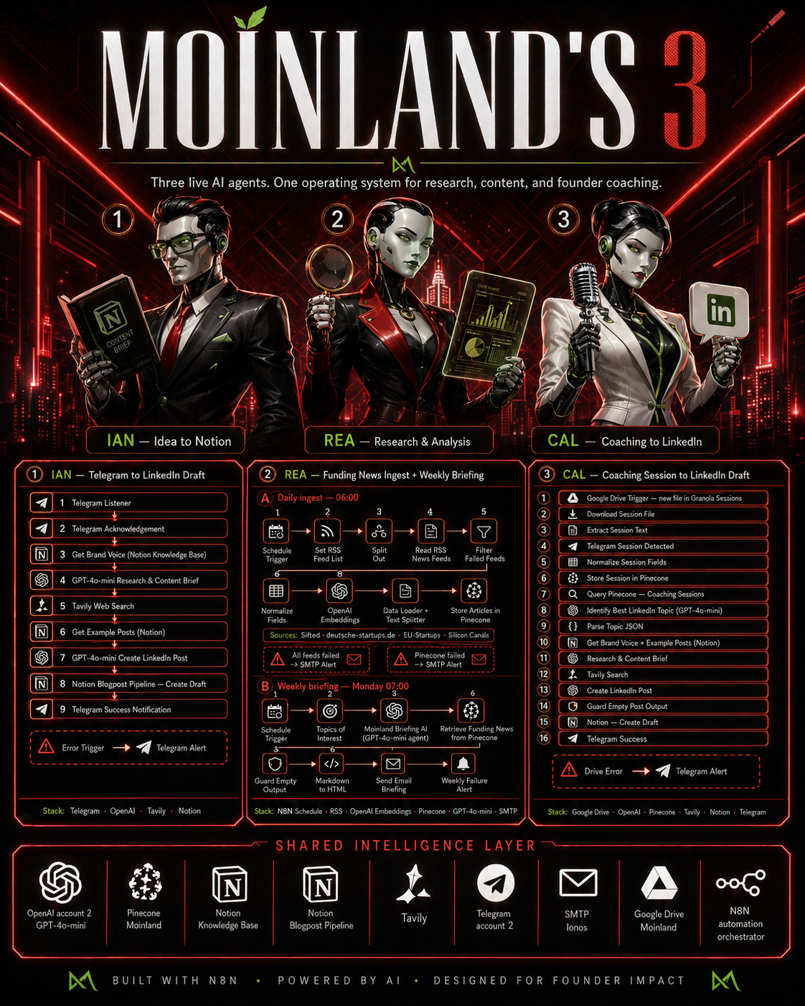
>> Meet your Agents

Slide 3
>> Meet your Agents

Slide 4
>> Meet your Agents

Slide 5
>> Meet your Agents

Slide 6
>> Meet your Agents

Slide 7
>> Meet your Agents

Slide 8
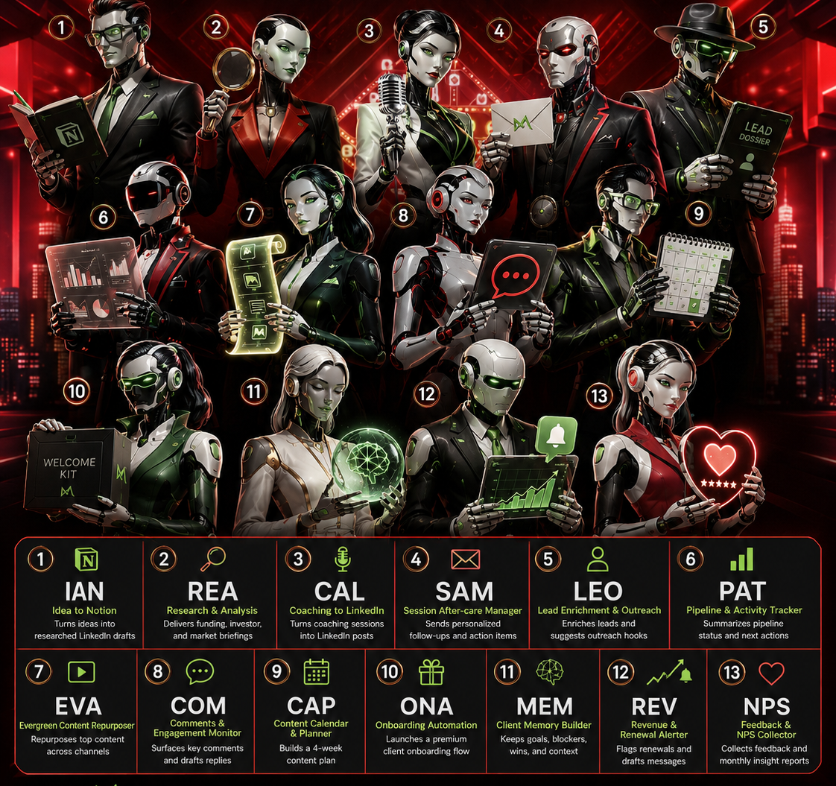
>> Moinland’s 13

Slide 9
ARCHIVE

Slide 10


1
1 IAN — Telegram idea to LinkedIn draft
Manual trigger · researches a topic · writes in Daniel’s voice · saves to Notion
Telegram idea
Brand voice
GPT brief
Tavily data
GPT post
Notion draft
TG success
Stack: Telegram · Notion Knowledge Base · OpenAI GPT-4o-mini · Tavily · Notion Blogpost Pipeline
IAN — Idea to Notion
SHARED INTELLIGENCE LAYER
OpenAI
Pinecone
Notion
Tavily
Telegram
Google Drive
SMTP
n8n
GPT + embeddings
Vector memory
KB + Pipeline
Web research
Notifications
Granola sessions
Email briefings
Orchestrator
BUILT WITH N8N • POWERED BY AI • DESIGNED FOR FOUNDER IMPACT

Slide 11
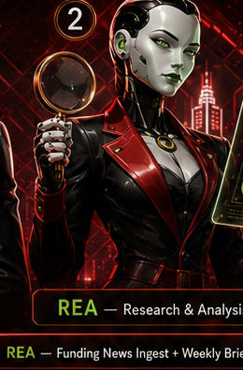
1
2
1 IAN — Content creation path
Telegram idea → researched LinkedIn draft → Notion pipeline
Telegram
GPT brief
Tavily
GPT post
Notion
TG alert
Output: Notion draft + Telegram success
IAN — Idea to Notion
REA — Research & Analysis
2 REA — Research intelligence path
Daily RSS ingest + weekly briefing loop
RSS feeds
Filter
Embed
Pinecone
GPT brief
Email
Sources: Sifted · deutsche-startups · EU-Startups · Silicon Canals · Output: Monday email briefing
SHARED INTELLIGENCE LAYER
OpenAI
Pinecone
Notion
Tavily
Telegram
Google Drive
SMTP
n8n
GPT + embeddings
Vector memory
KB + Pipeline
Web research
Notifications
Granola sessions
Email briefings
Orchestrator
BUILT WITH N8N • POWERED BY AI • DESIGNED FOR FOUNDER IMPACT

Slide 12
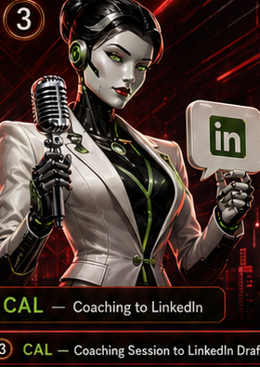
1
2
3
IAN — Idea to Notion
REA — Research & Analysis
CAL — Coaching to LinkedIn
1 IAN — Idea to Notion
2 REA — Research & Analysis
3 CAL — Coaching to LinkedIn
Topic input becomes a researched LinkedIn draft
Market signal engine: ingest, embed, retrieve, brief
Granola session becomes an evidence-backed post
Telegram
Voice
GPT
Tavily
Notion
RSS
Clean
Embed
Pinecone
Email
Drive
Extract
Pinecone
Topic AI
Draft
Output: Blogpost Pipeline + Telegram
Output: Weekly funding/investor briefing
Output: Notion draft + Telegram
SHARED INTELLIGENCE LAYER
OpenAI
Pinecone
Notion
Tavily
Telegram
Google Drive
SMTP
n8n
GPT + embeddings
Vector memory
KB + Pipeline
Web research
Notifications
Granola sessions
Email briefings
Orchestrator
BUILT WITH N8N • POWERED BY AI • DESIGNED FOR FOUNDER IMPACT

Slide 13
MOINLAND'S AI OPERATING SYSTEM
Three live AI agents — built with N8N · powered by AI · designed for founder impact
1
IAN
Idea to Notion · Telegram → LinkedIn Draft
1
Telegram Listener & Acknowledgement
2
Get Brand Voice (Notion Knowledge Base)
3
GPT-4o-mini Research & Content Brief
4
Tavily Web Search
REA + CAL
coming next
5
Get Example Posts (Notion)
6
GPT-4o-mini Create LinkedIn Post
7
Notion Blogpost Pipeline — Create Draft
8
Telegram Success Notification
Stack: Telegram · OpenAI · Tavily · Notion
SHARED INTELLIGENCE LAYER
OpenAI
Pinecone
Notion KB
Notion BP
Tavily
Telegram
SMTP
Google Drive
N8N
GPT-4o-mini
Moinland DB
Knowledge Base
Blogpost Pipeline
Web Search
Account 2
Ionos Mail
Moinland
Orchestrator

Slide 14
MOINLAND'S AI OPERATING SYSTEM
Three live AI agents — built with N8N · powered by AI · designed for founder impact
1
IAN
2
REA
Idea to Notion · Telegram → LinkedIn Draft
Research & Analysis · Funding News + Weekly Briefing
1
Telegram Listener & Acknowledgement
1
Daily 06:00 — Schedule, Set RSS Feed, Split, Read, Filter
2
Get Brand Voice (Notion Knowledge Base)
2
Normalize Fields → OpenAI Embeddings → Store in Pinecone
3
GPT-4o-mini Research & Content Brief
3
Weekly Mon 07:00 — Topics of Interest via GPT-4o-mini
4
Tavily Web Search
4
Retrieve Funding News from Pinecone
5
Get Example Posts (Notion)
5
Markdown → HTML → Send Email Briefing
CAL
next
6
GPT-4o-mini Create LinkedIn Post
7
Notion Blogpost Pipeline — Create Draft
8
Telegram Success Notification
Stack: Telegram · OpenAI · Tavily · Notion
Stack: N8N Schedule · RSS · OpenAI · Pinecone · SMTP
SHARED INTELLIGENCE LAYER
OpenAI
Pinecone
Notion KB
Notion BP
Tavily
Telegram
SMTP
Google Drive
N8N
GPT-4o-mini
Moinland DB
Knowledge Base
Blogpost Pipeline
Web Search
Account 2
Ionos Mail
Moinland
Orchestrator

Slide 15
MOINLAND'S AI OPERATING SYSTEM
Three live AI agents — built with N8N · powered by AI · designed for founder impact
1
IAN
2
REA
3
CAL
Telegram → LinkedIn Draft
Funding News + Weekly Briefing
Coaching Session → LinkedIn Draft
1
Telegram Listener & Acknowledgement
1
Daily 06:00 — Schedule, Set RSS Feed, Split, Read, Filter
1
Google Drive Trigger — new file in Granola Sessions
2
Get Brand Voice (Notion Knowledge Base)
2
Normalize Fields → OpenAI Embeddings → Store in Pinecone
2
Download & Extract Session Text
3
GPT-4o-mini Research & Content Brief
3
Weekly Mon 07:00 — Topics of Interest via GPT-4o-mini
3
Telegram Detected → Normalize → Store in Pinecone
4
Tavily Web Search
4
Retrieve Funding News from Pinecone
4
Query Pinecone → Identify Best LinkedIn Topic (GPT-4o-mini)
5
Get Example Posts (Notion)
5
Markdown → HTML → Send Email Briefing
5
Parse Topic → Get Brand Voice + Example Posts (Notion)
6
GPT-4o-mini Create LinkedIn Post
6
Tavily Search → Create LinkedIn Post
7
Notion Blogpost Pipeline — Create Draft
7
Guard Output → Notion Draft → Telegram Success
8
Telegram Success Notification
Stack: Telegram · OpenAI · Tavily · Notion
Stack: N8N · RSS · OpenAI · Pinecone · SMTP
Stack: Google Drive · OpenAI · Pinecone · Tavily · Notion · Telegram
SHARED INTELLIGENCE LAYER
OpenAI
Pinecone
Notion KB
Notion BP
Tavily
Telegram
SMTP
Google Drive
N8N
GPT-4o-mini
Moinland DB
Knowledge Base
Blogpost Pipeline
Web Search
Account 2
Ionos Mail
Moinland
Orchestrator

